Slide 1
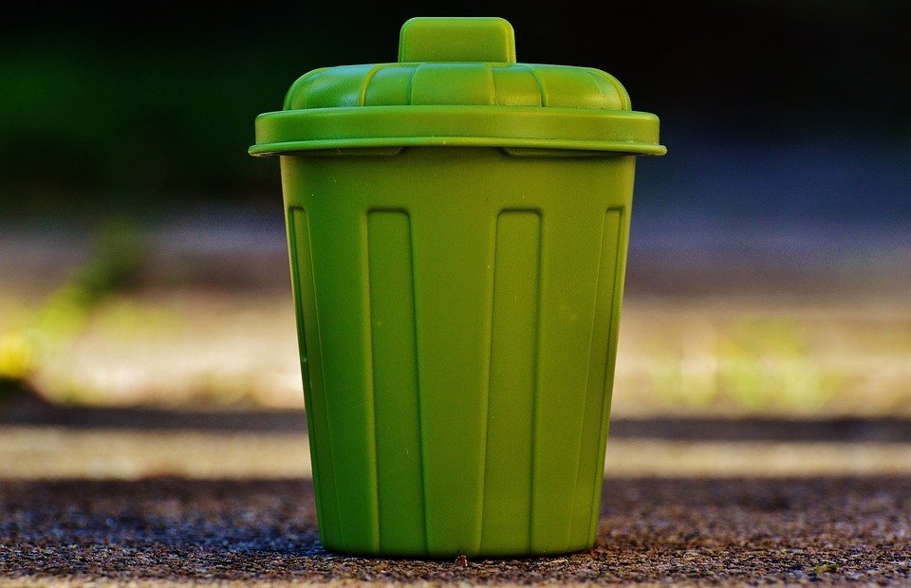
Development of Smart Waste Management System based on IoT platform

Slide 2


Mini Project By:
SHIVA SAI(18BEC012)
KIRAN D(18BEC022)
NIKHIL S A(18BEC033)
NITHIN R(18BEC034)
Project Guide:
Dr. Prakash Pawar

Slide 3

PROBLEM STATEMENT:
The main problems of the existing solid waste collection process and management system are as follows.
1.Lack of the information about the collecting time and area.
2.Lack of the proper system for monitoring, tracking the trucks and trash bins that have been collected in real time.
3.One of the main concerns with our environment has been solid waste management which impacts the health and environment of our society.
4.There is no quick response to urgent cases like truck accident, breakdown, longtime idling.
5.There is no quick way to response to client's complaints about uncollected waste.

Slide 4
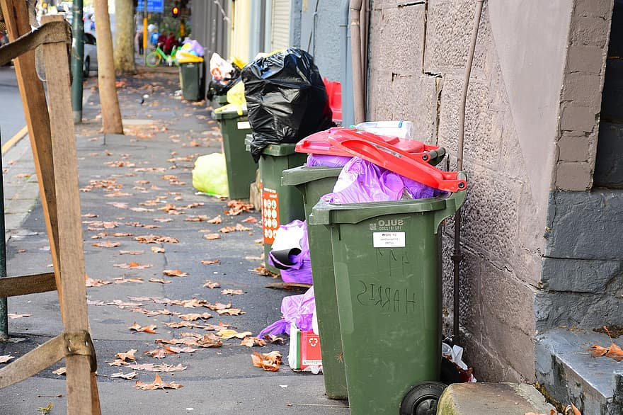
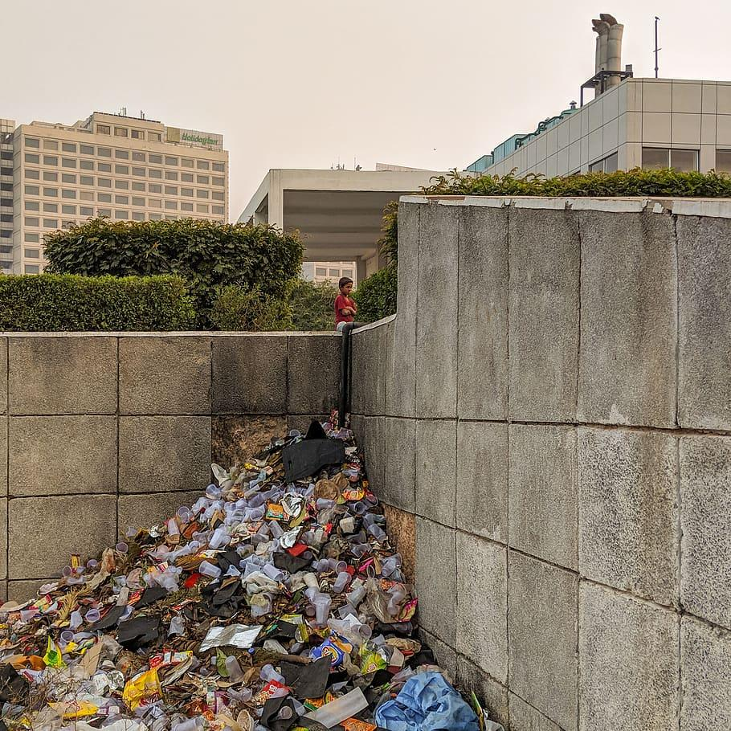
Examples:

Slide 5

SOLUTION:
What our system does is it gives a real time indicator of the garbage level in a trash can at any given time.
Using that data we can then optimize waste collection routes and ultimately reduce fuel consumption. It allows trash collectors to plan their daily/weekly pick up schedule.
We can implement our project in our brand new campus to maintain cleanliness and hygiene.

Slide 6
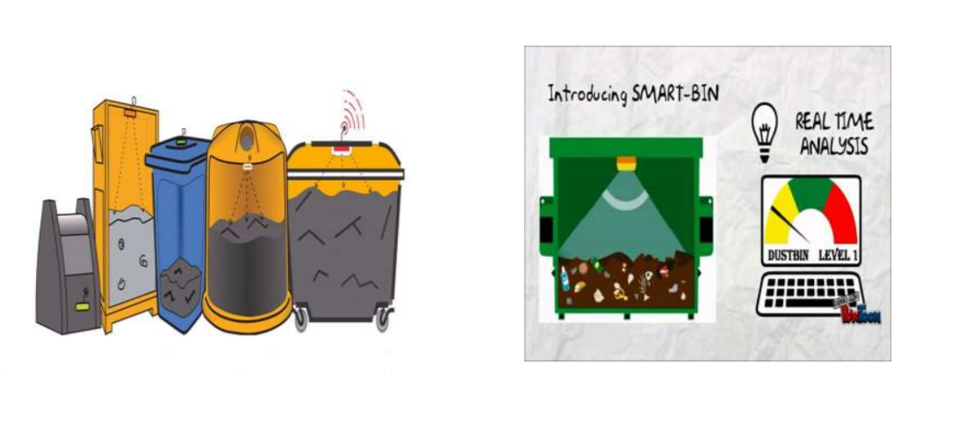

Slide 7
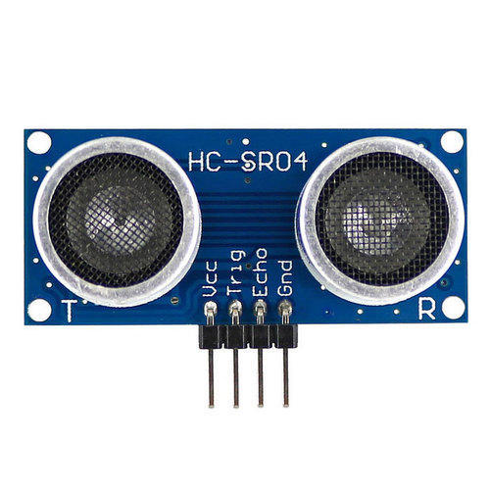
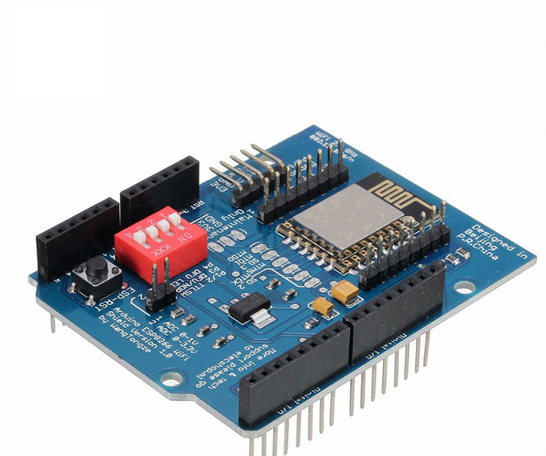
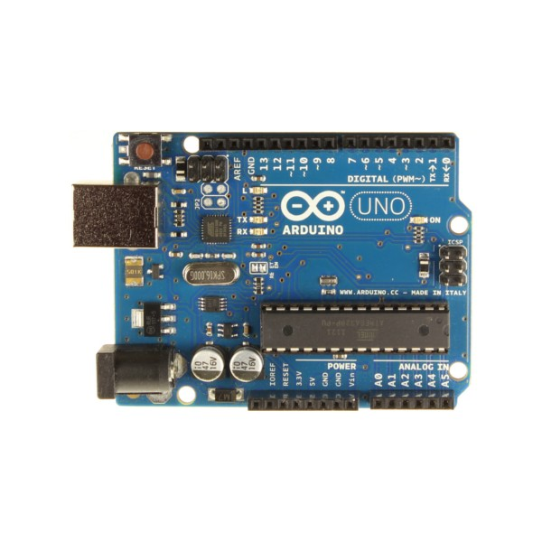
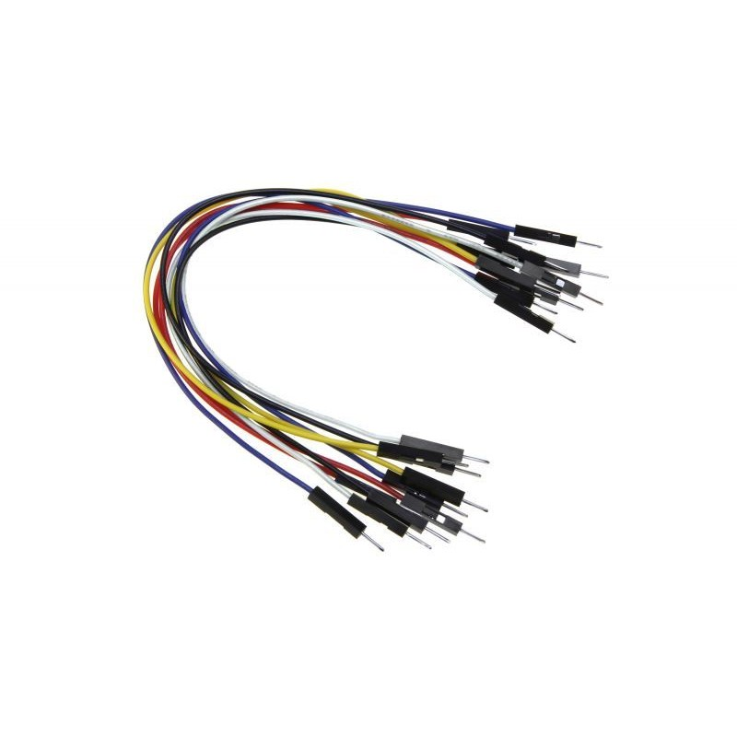
Components Required for designing:
1)Ultrasonic sensor 3)Wifi Shield
2)Arduino uno 4)Connecting wires.

Slide 8

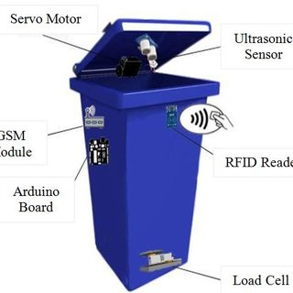
An ultrasonic sensor will be placed on the interior side of the lid, the one facing the solid waste. As trash increases, the distance between the ultrasonic and the trash decreases. This live data will be sent to our microcontroller.

